Slide 1



Phenological plasticity:
Shifting growth and developmental phases of North American tree species in response to environmental stressors
Frederik Baumgarten, University of British Columbia
Notes:
Good morning, my name is xx. I present you some first results and a conceptual framework of my postdoc at UBC

Slide 2
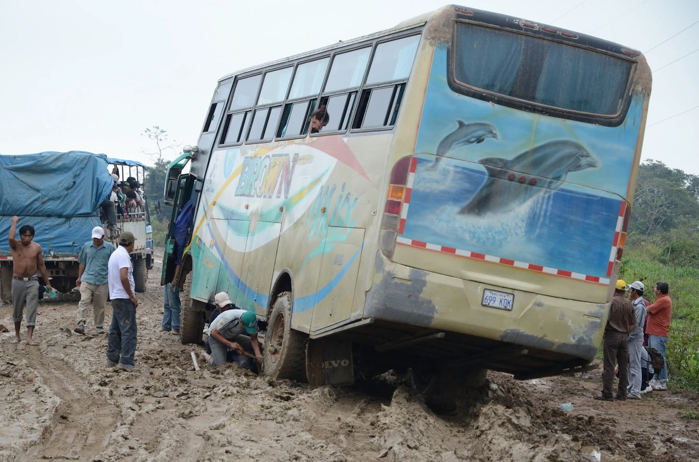
Notes:
I want to start with a story that inspired this project. I love public transport. This was on a trip in Bolivia and it illustrates

Slide 3
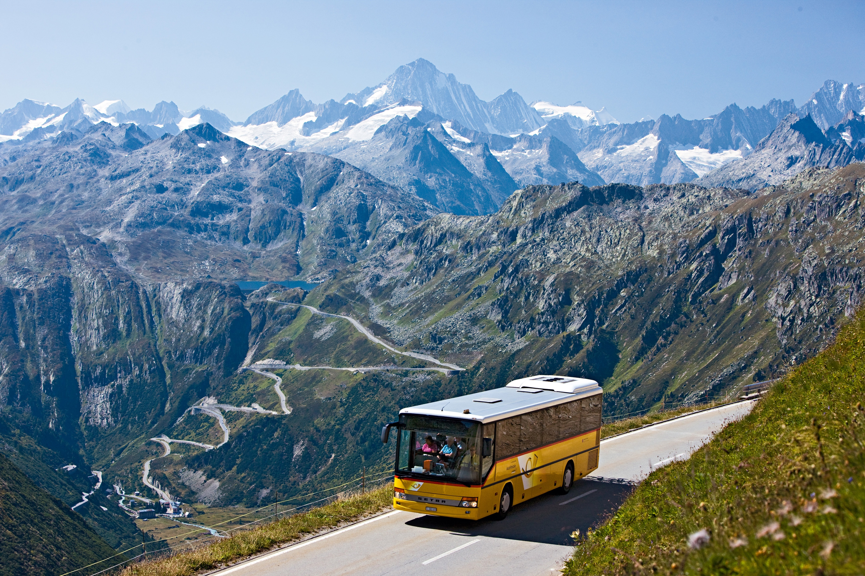

Slide 4
Swiss transport:
very punctual
Conservative (fixed route and stops)
Bolivian transport:
high uncertainty
Flexible (improvised route and stops)
Notes:
Both systems are very effective and successfully transport people. So even if you see some repair here, we actually managed to get there!

Slide 5


Jan
Feb
Mar
Apr
May
Jun
Jul
Aug
Sep
Oct
Nov
Dec
Potential growing season
Notes:
Bus stops at different pheno stages and we can formulate the following hypothesis.

Slide 6
Jan
Feb
Mar
Apr
May
Jun
Jul
Aug
Sep
Oct
Nov
Dec
control
Growth rate
Potential growing season
Notes:
Imagine a tree growing within the window of opportunity where environmental conditions are favourable. Due to internal constraints growth does not happen during the whole time, e.g. switch in ressource allocation to reproduction or storage

Slide 7
Stressor (2 weeks drought)
Jan
Feb
Mar
Apr
May
Jun
Jul
Aug
Sep
Oct
Nov
Dec
control
Growth rate
Potential growing season
Notes:
If a stress occurs we can imagine two possible responses

Slide 8
Stressor (2 weeks drought)
Jan
Feb
Mar
Apr
May
Jun
Jul
Aug
Sep
Oct
Nov
Dec
control
conservative (Swiss style)
Growth rate
Potential growing season

Slide 9
Stressor (2 weeks drought)
Jan
Feb
Mar
Apr
May
Jun
Jul
Aug
Sep
Oct
Nov
Dec
control
conservative (Swiss style)
Growth rate
flexible (Bolivian style)
Potential growing season

Slide 10
Research Questions
How plastic are trees in rearranging their development and growth over the growing season if impacted by a stressor?
When is tree growth most affected by drought?
Which strategy maximizes biomass production by shifting/extending growth activities?
Notes:
And which traits are involved

Slide 11
Study Design
6 species:
Prunus virginiana
Betula papyrifera
Acer macrophyllum
Quercus garryana
Pinus contorta
Sequoia sempervirens
Notes:
Check different responses across many different species all from different families
Average temperature curve of the greenhouse site
With the treatment timings.
Drought and defoliation. Here I present only drought

Slide 12
Study Design
6 species:
Prunus virginiana
Betula papyrifera
Acer macrophyllum
Quercus garryana
Pinus contorta
Sequoia sempervirens
Drought events -> sink limitation
Defoliation events -> source limitation

Slide 13
Campus at UBC

Slide 14
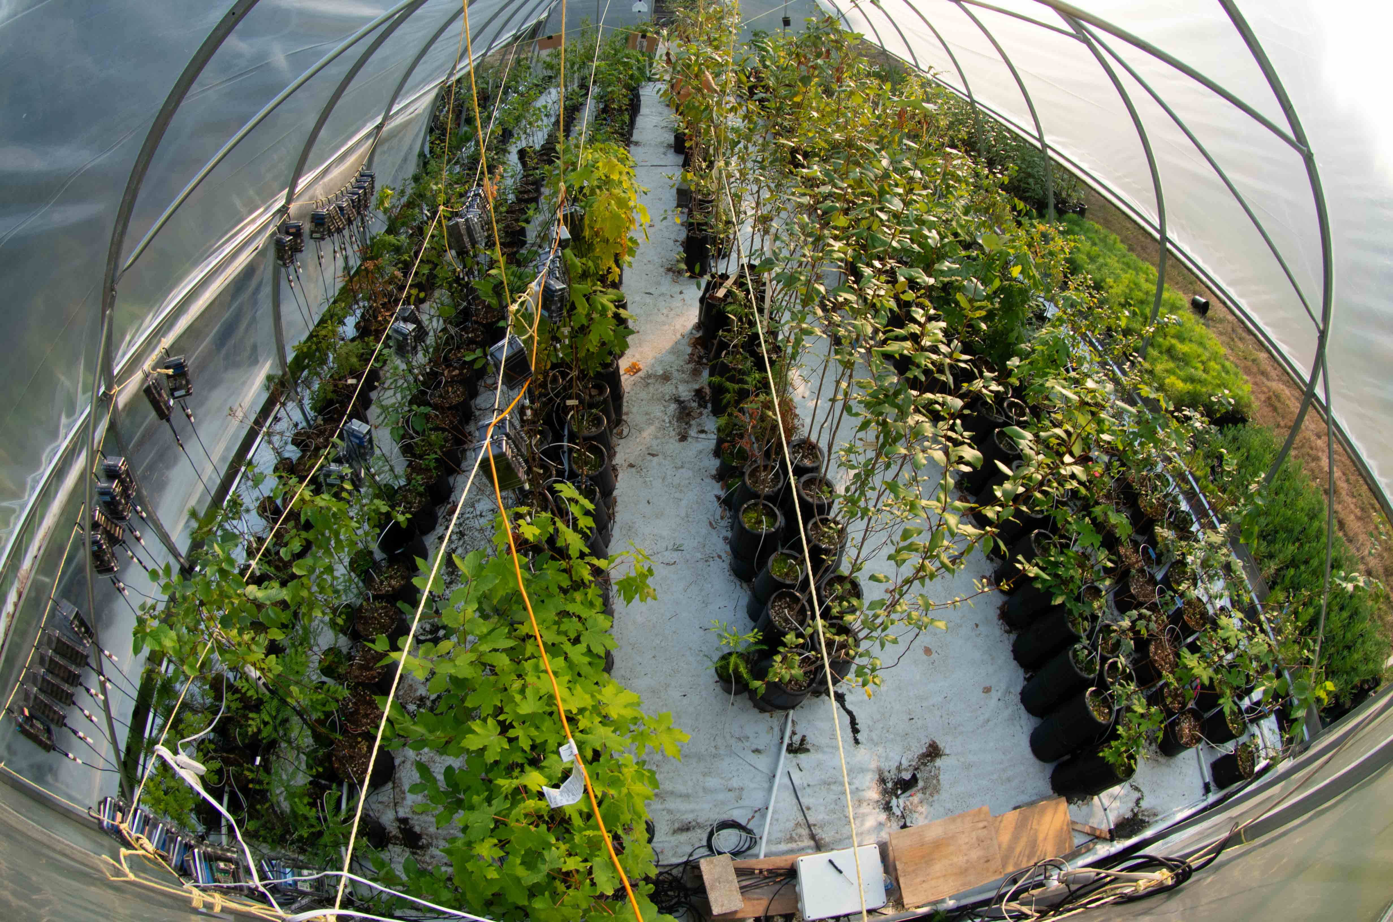
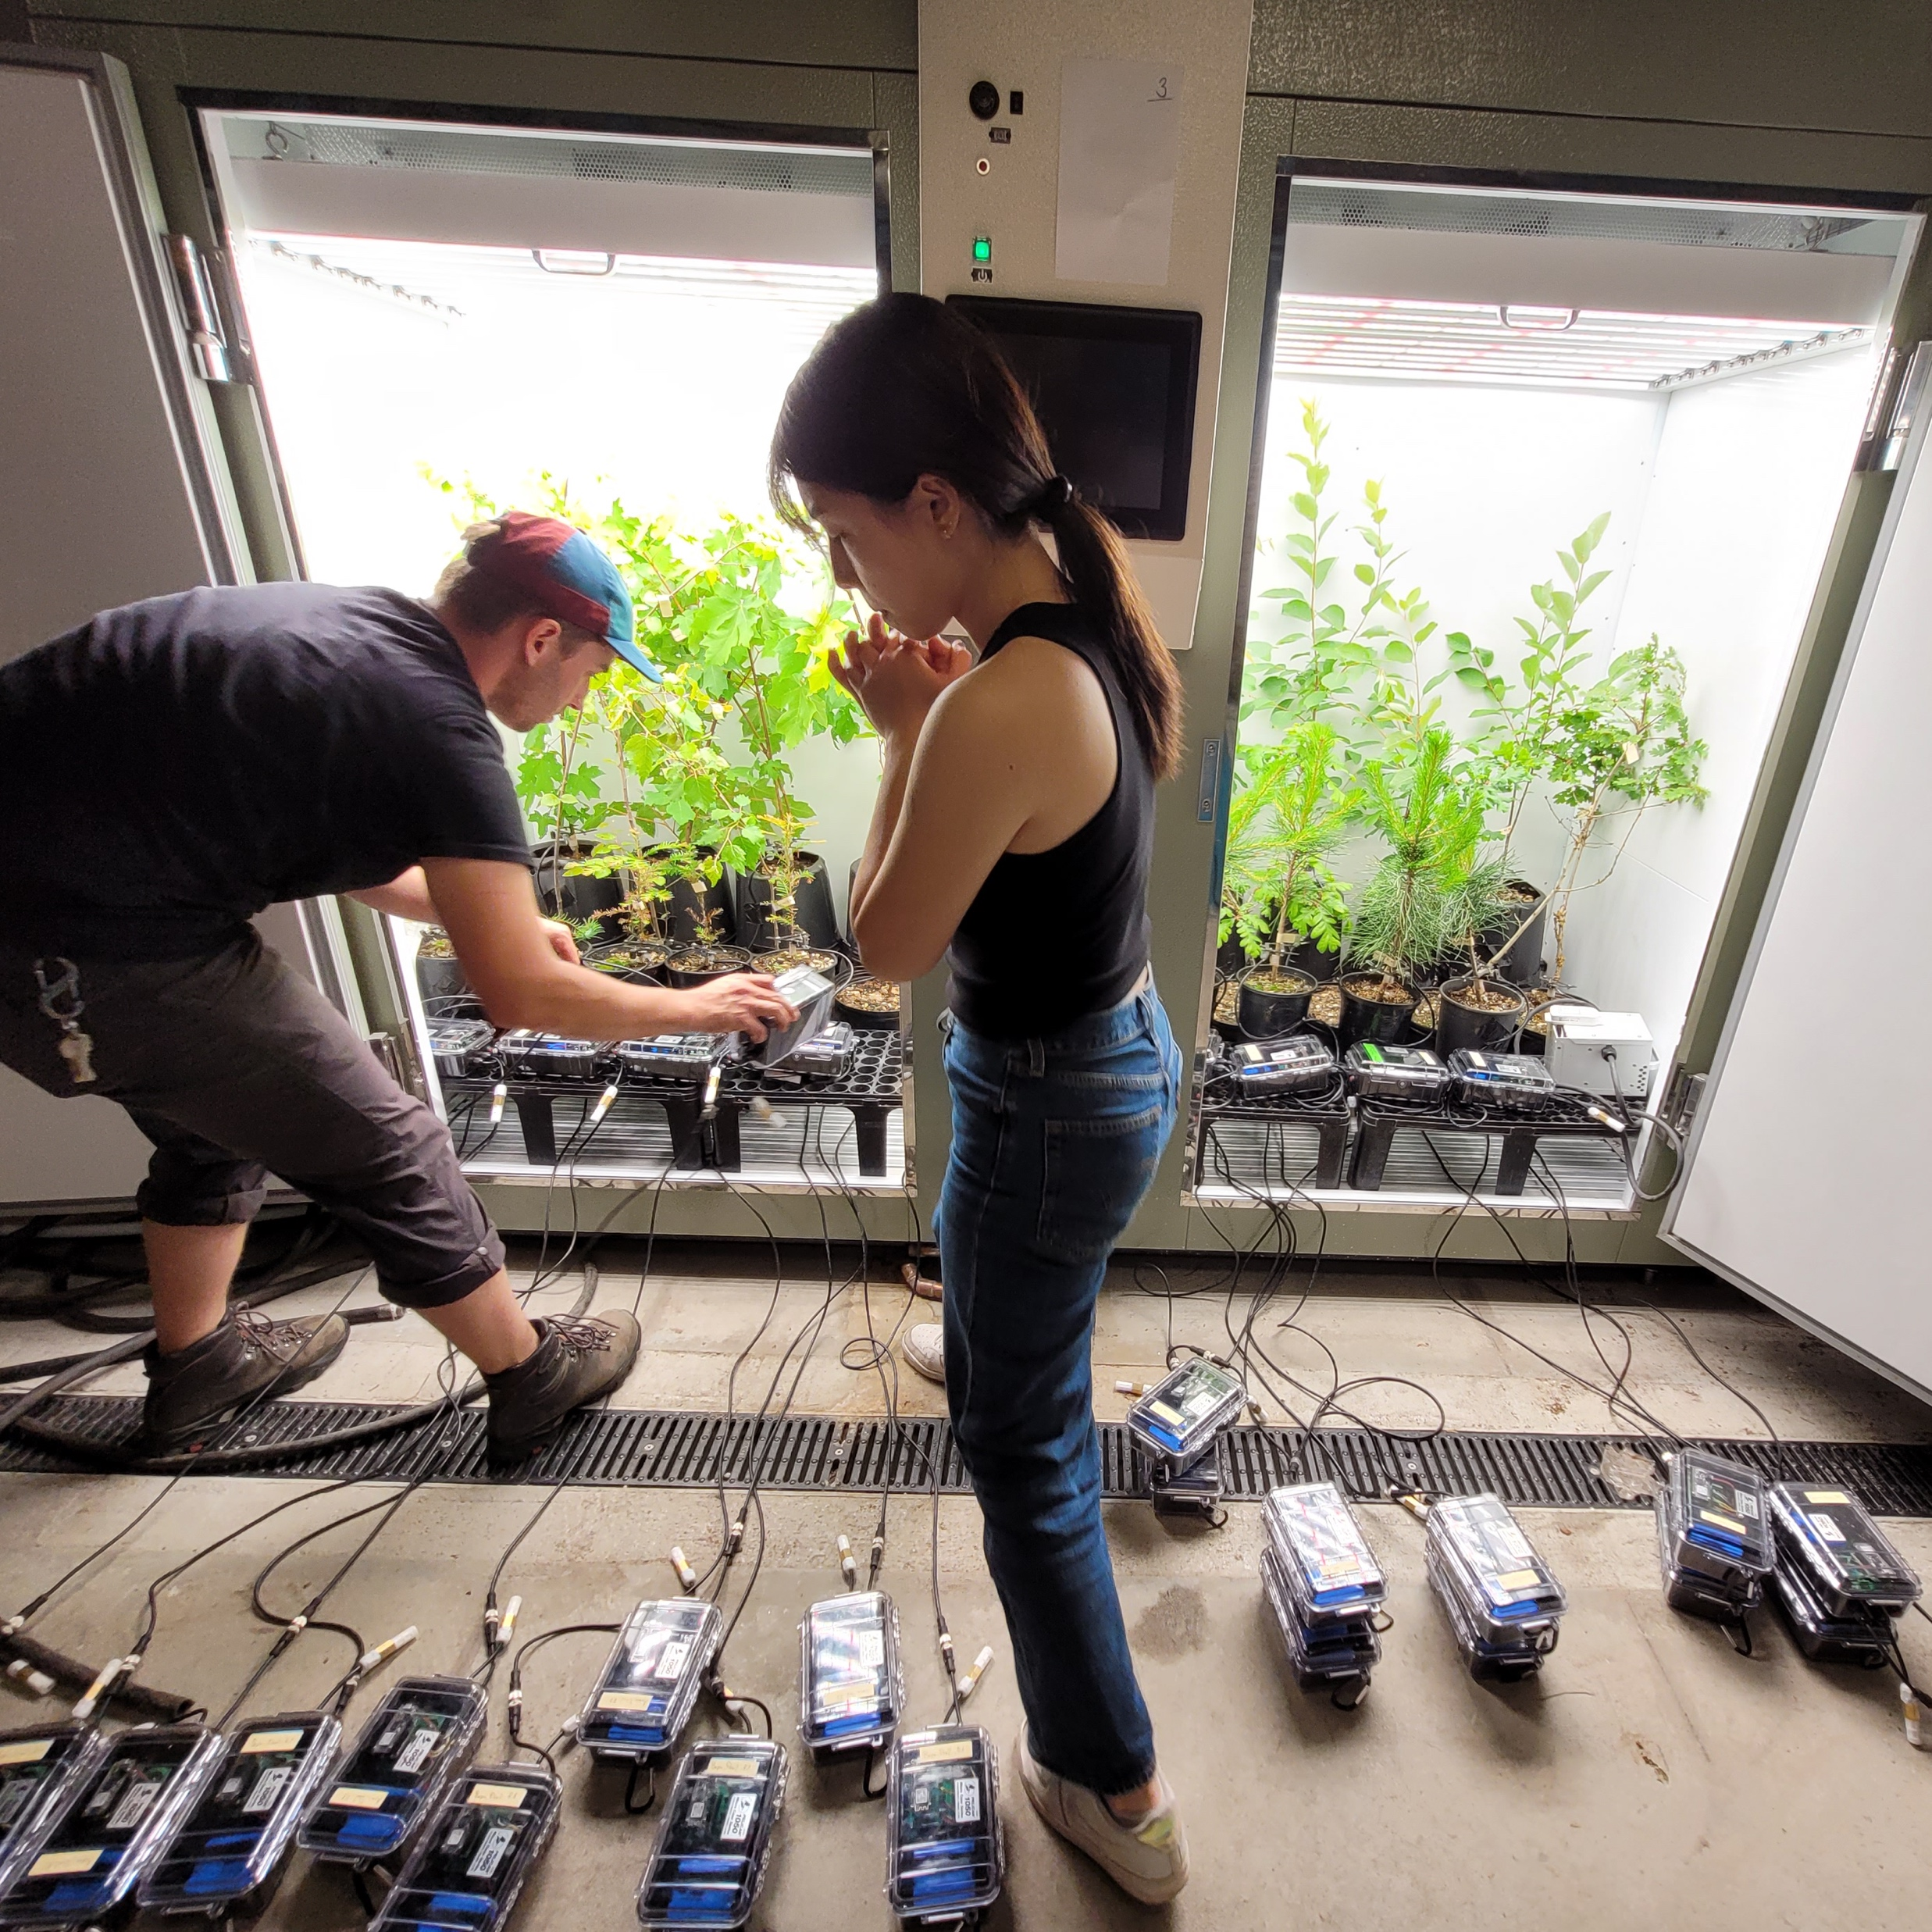
Experimental Setup
Polytunnel
Climate chambers
Notes:
In a polytunnel fully irrigated
For the drought treatment, transfer into a climate chamber until first symptoms of leaf dessication

Slide 15
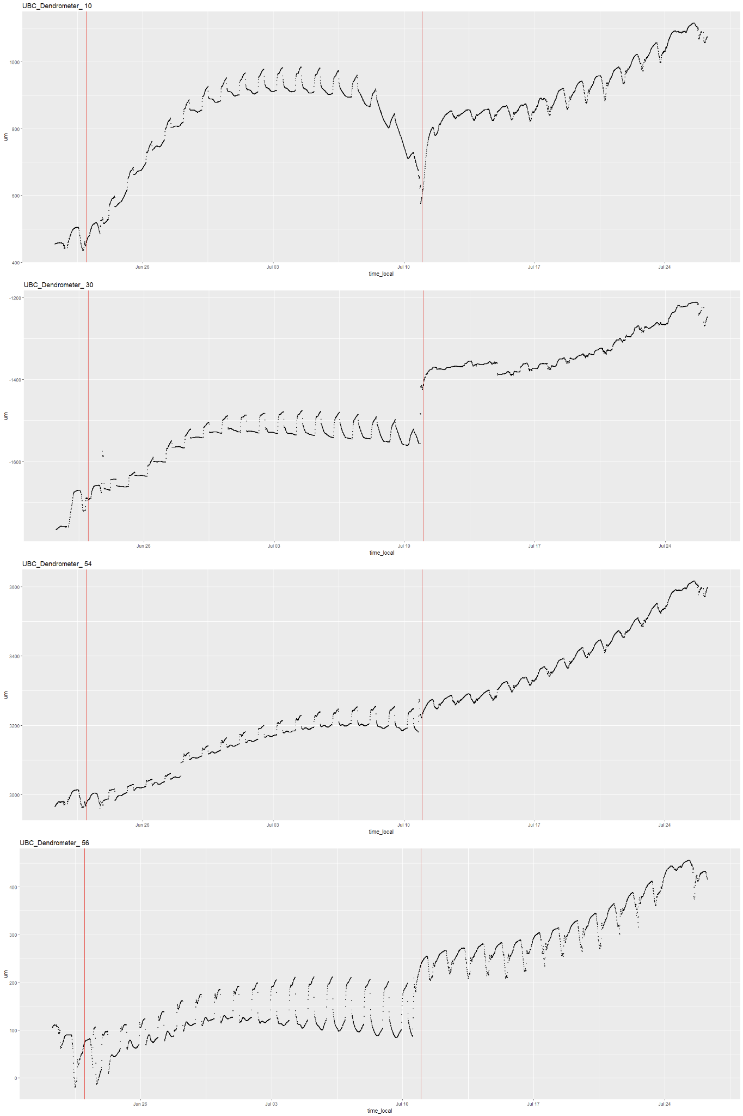
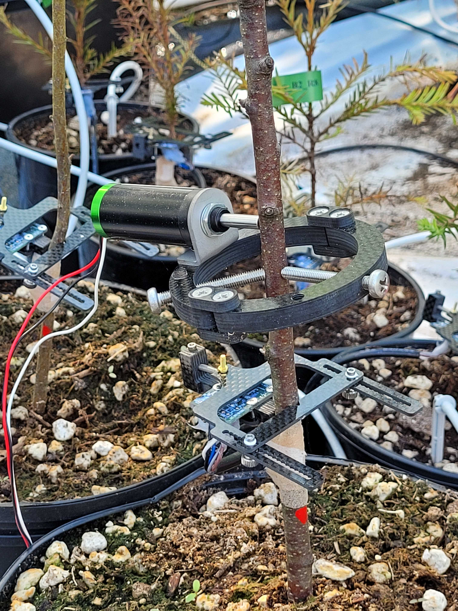
Notes:
I am still not sure what would be the best way to analyse this

Slide 16
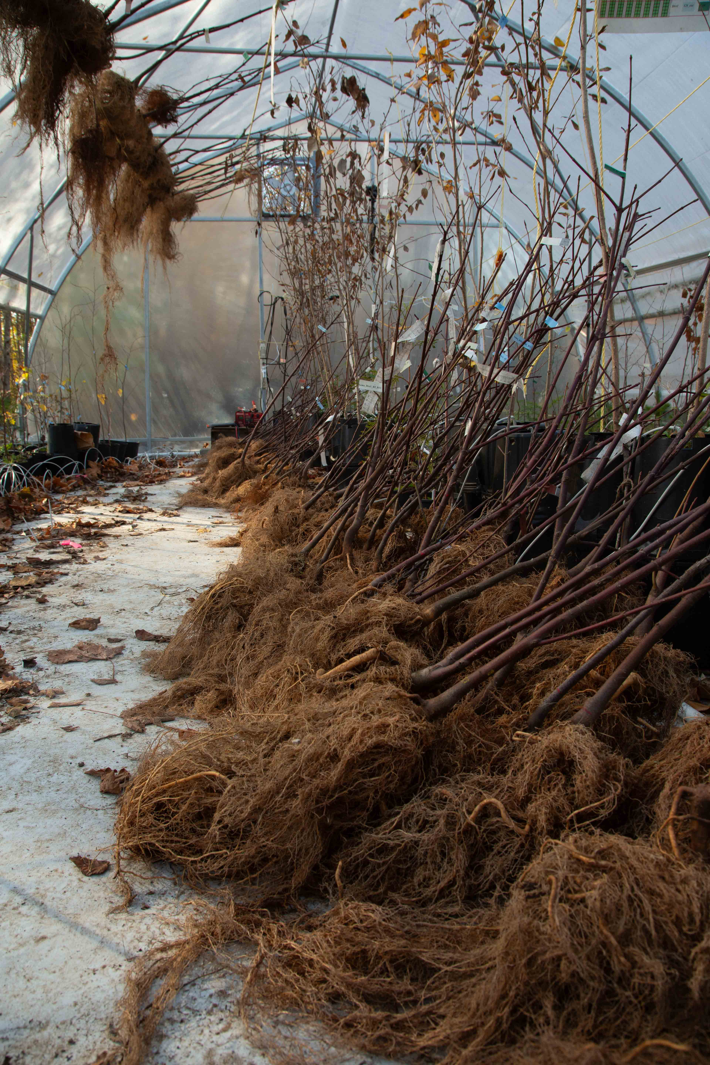
Total Biomass
Late drought impact for species exhibiting a late growing strategy (indeterminate growers)
Notes:
Diverse responses of these species steming from different families. One important trait

Slide 17
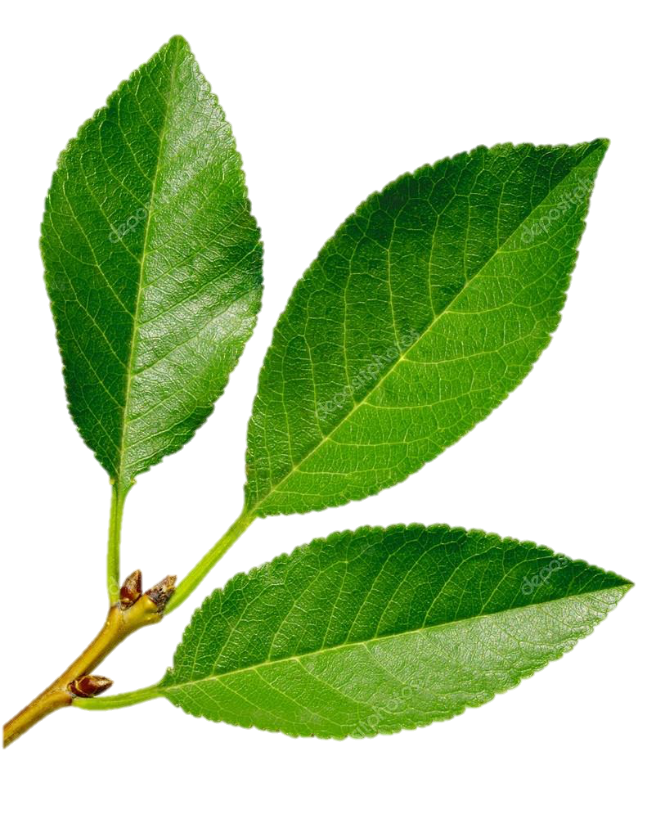

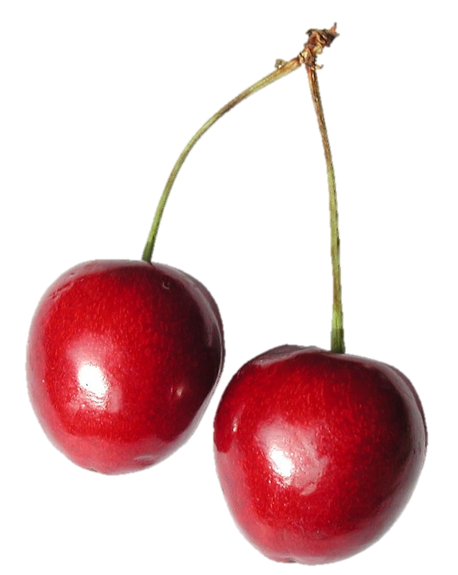
Total Biomass
Notes:
It appears that there are two patterns: Either a species was barely affected at all or it was increasingly affected with later timing of the drought. This is exemplified by these two species, but a similar pattern

Slide 18
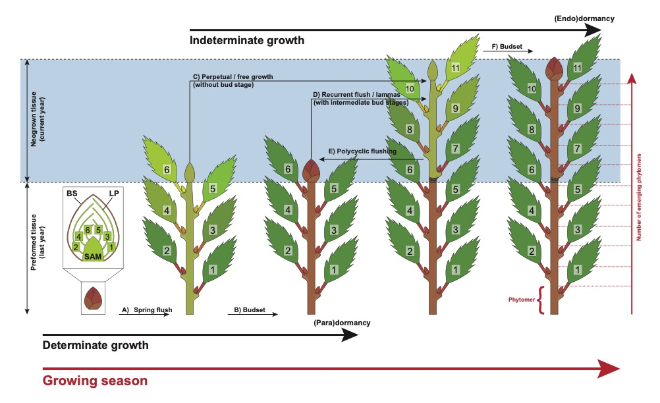

Degree of Determinism
Betula papyrifera

Slide 19
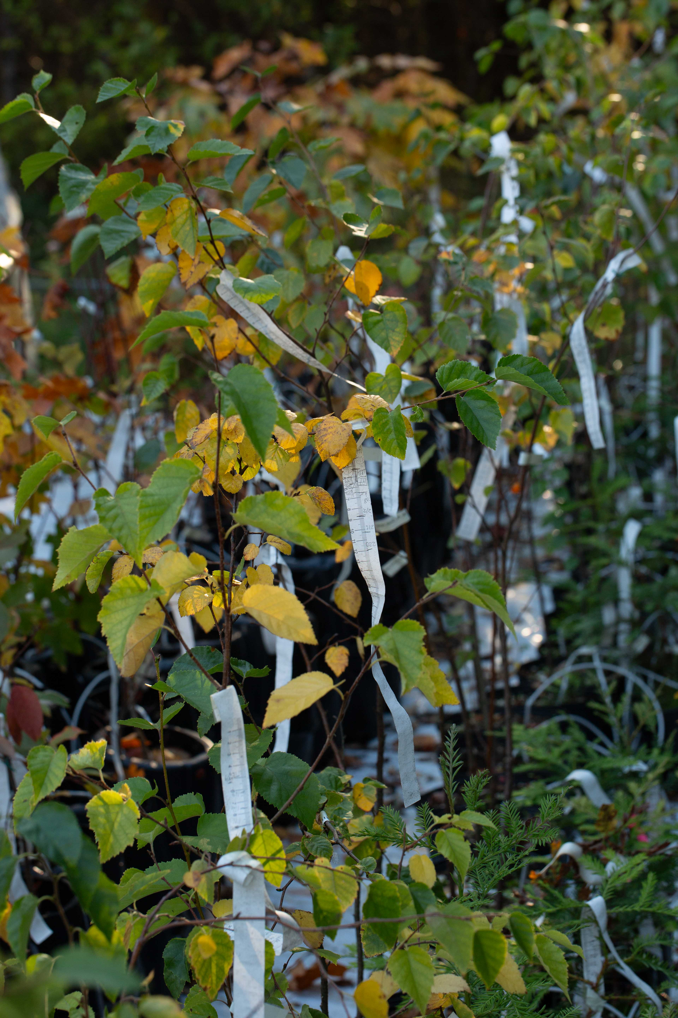
Shoot Extention

Slide 20
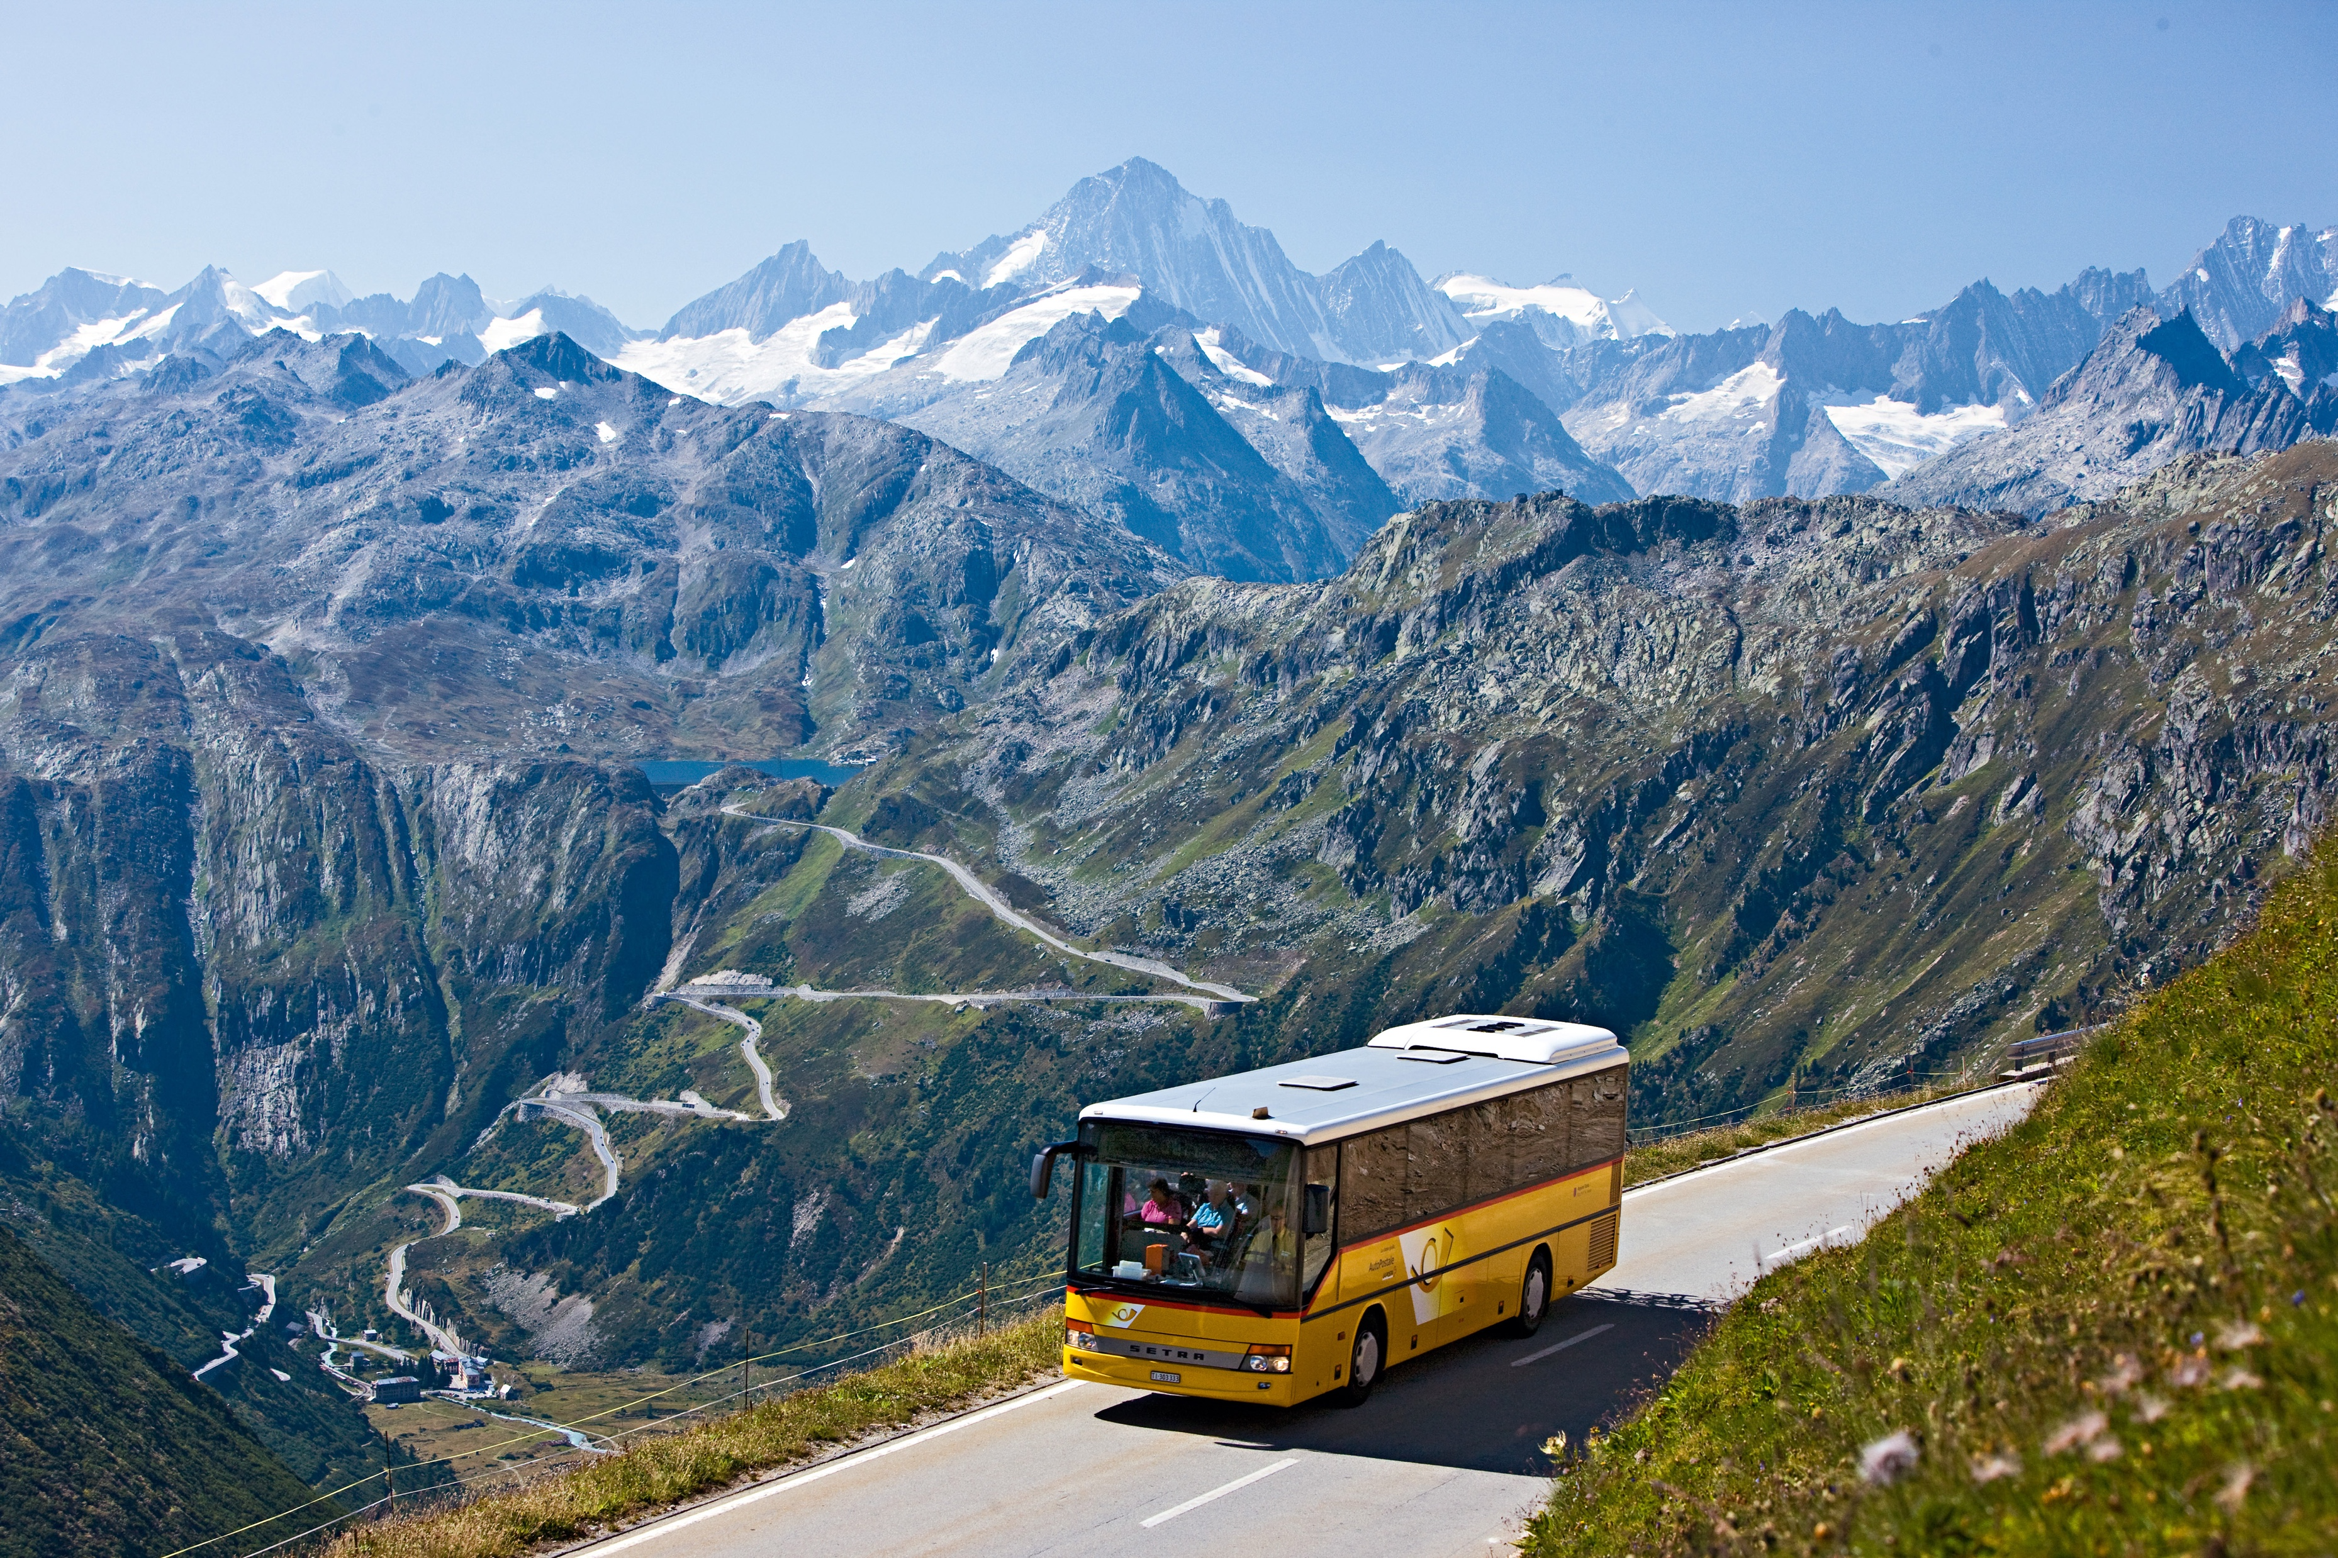
Which Bus to take?
“Swiss style”
Determinate growth
(all tissue preformed)
“Bolivian style”
Indeterminate growth
(neoformation of tissue possible)
Notes:
Which species wins?
Could be linked to this trait?

Slide 21
Which Bus wins?
Drought timing matters: Higher impact during formation of tissue (internal growth schedule)

Slide 22
Which Bus wins?
Drought timing matters: Higher impact during formation of tissue (internal growth schedule)
Degree of determinacy might be an important trait shaping stress responses with:
-> Determinate species being less impacted by stress in the current season
-> Indeterminate species being more impacted, especially later in the season

Slide 23
Which Bus wins?
Drought timing matters: Higher impact during formation of tissue (internal growth schedule)
Degree of determinacy might be an important trait shaping stress responses with:
-> Determinate species being less impacted by stress in the current season
-> Indeterminate species being more impacted, especially later in the season
Legacy effects: Impact on tissue preformation on the next growing season

Slide 24
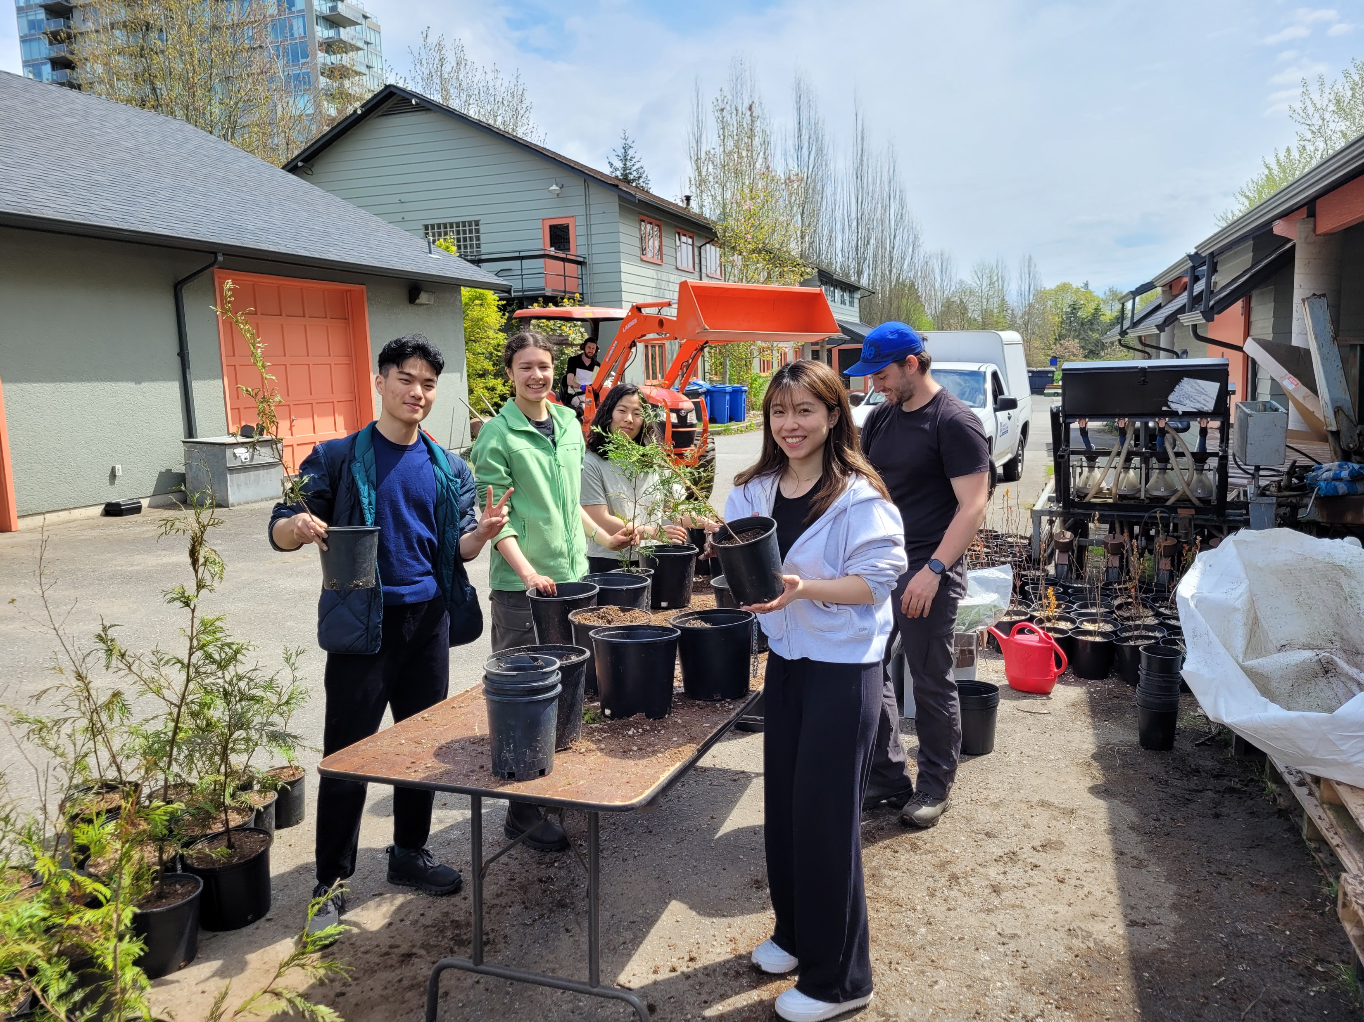
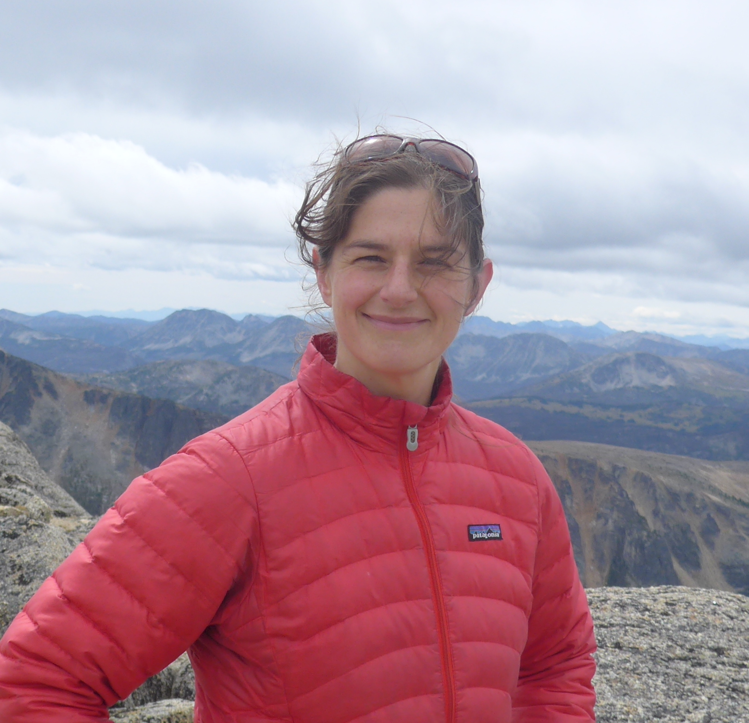
Thanks to…
Lizzie Wolkovich
Temporal Ecology Lab, UBC, Canada
Notes:
Perhaps add it to the slide with the many roots?

Slide 25
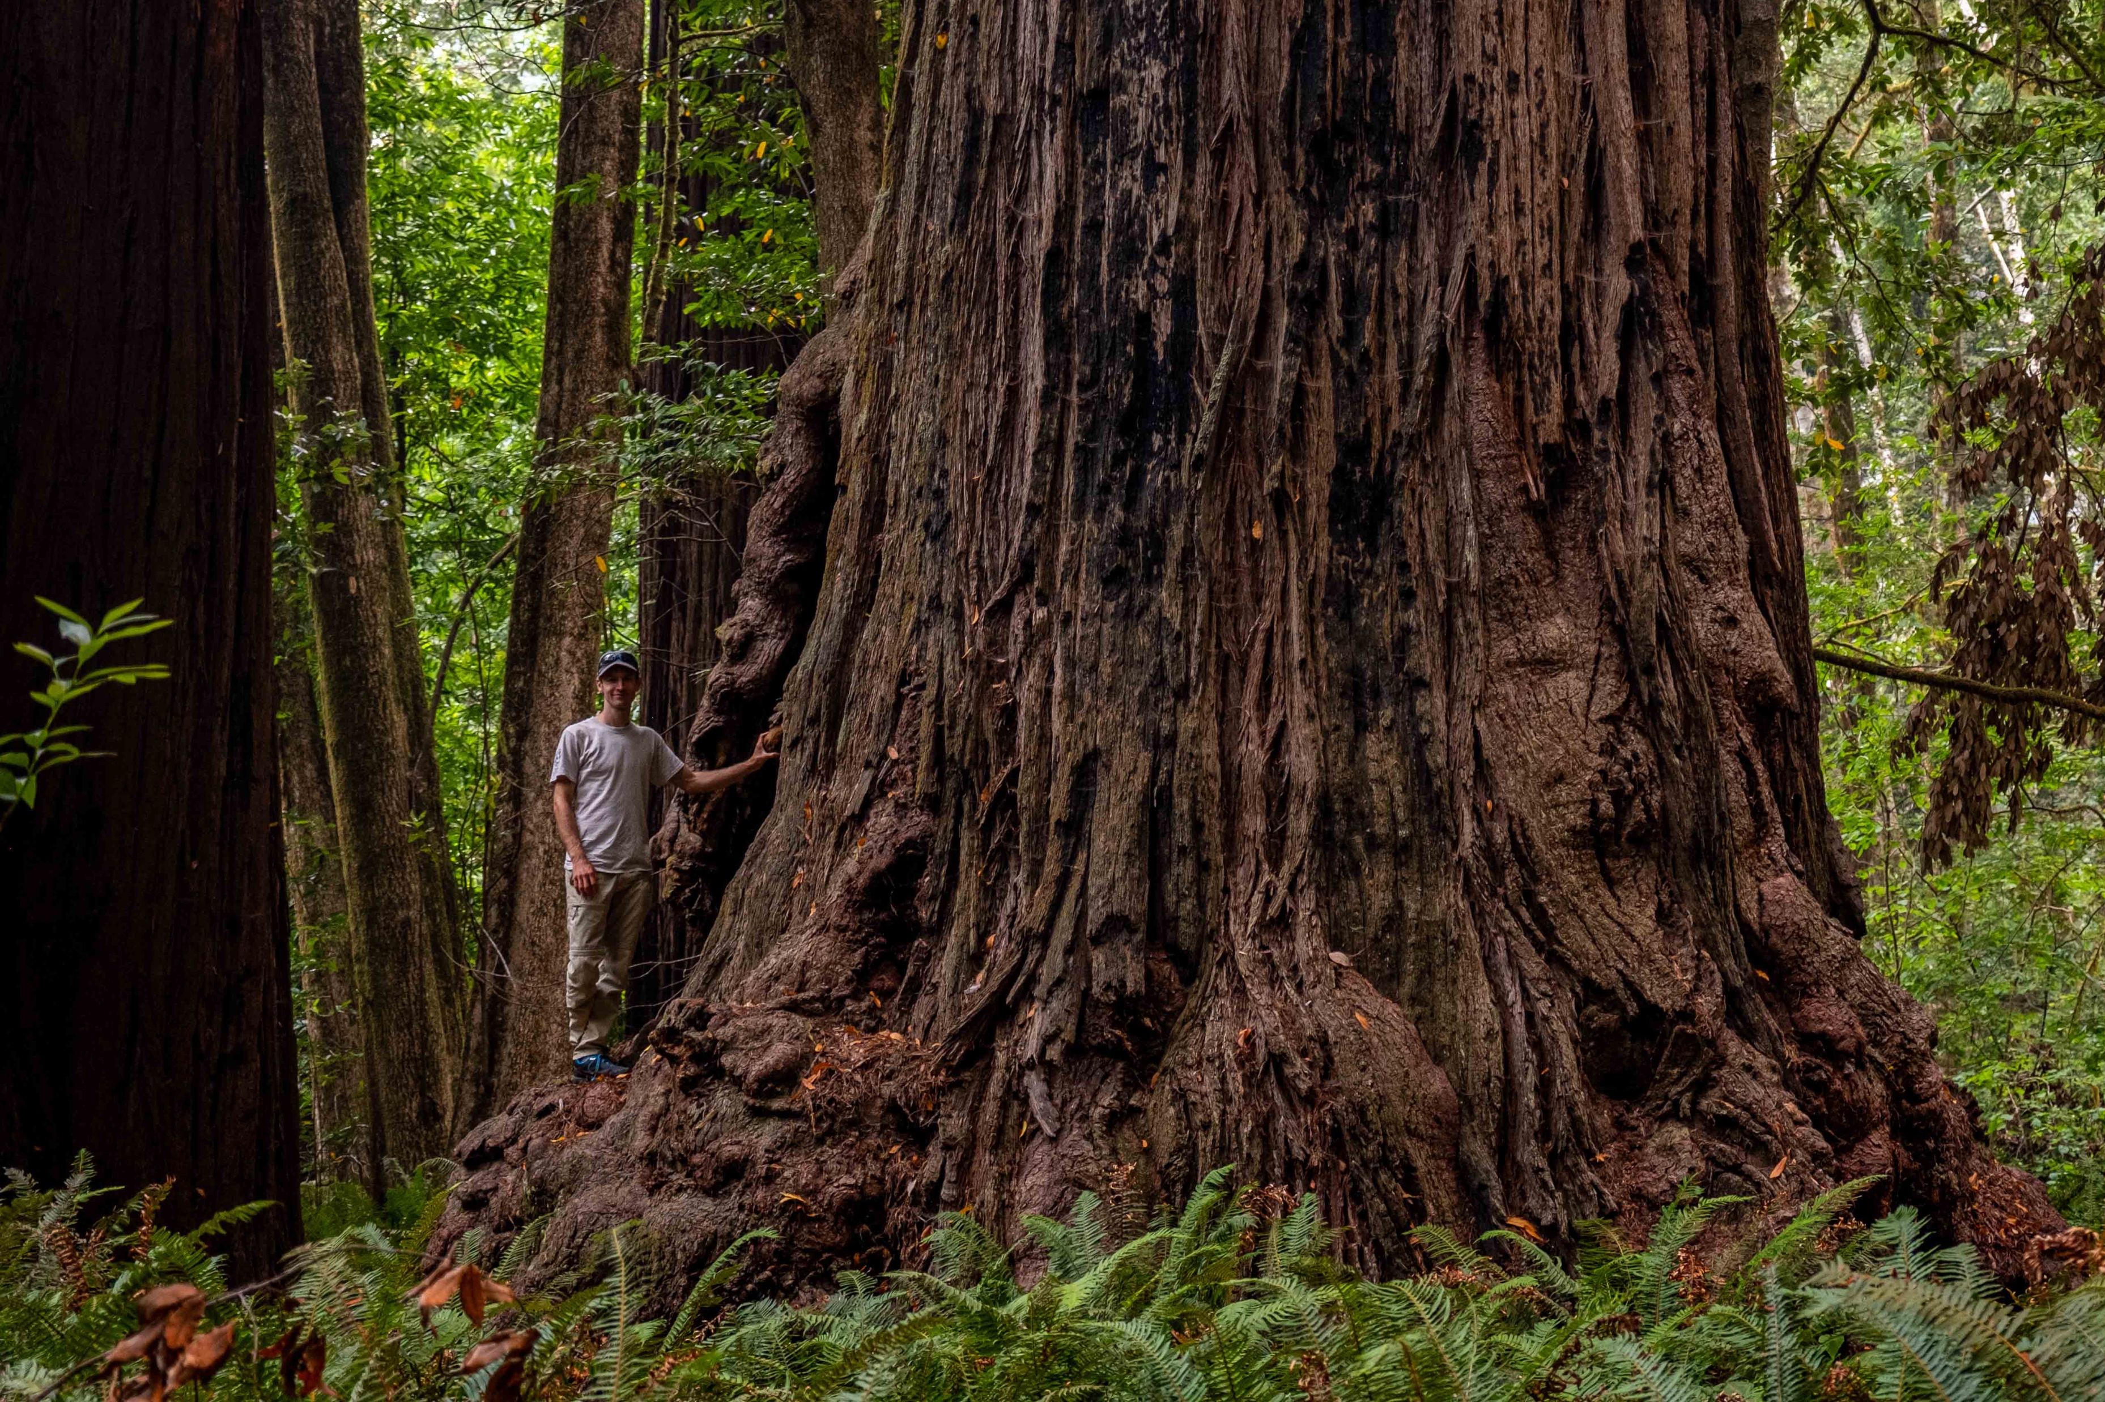
Questions?
Contact:
Temporal Ecology Lab, UBC, Canada
frederik.baumgarten@ubc.ca
Notes:
Aim:
Good to connect

Slide 26
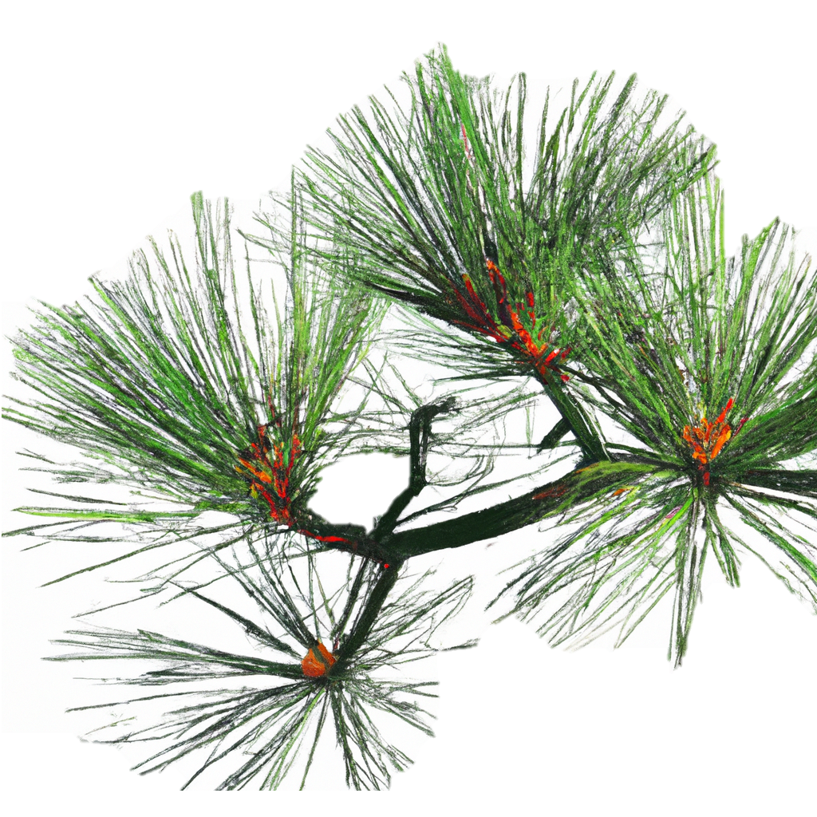
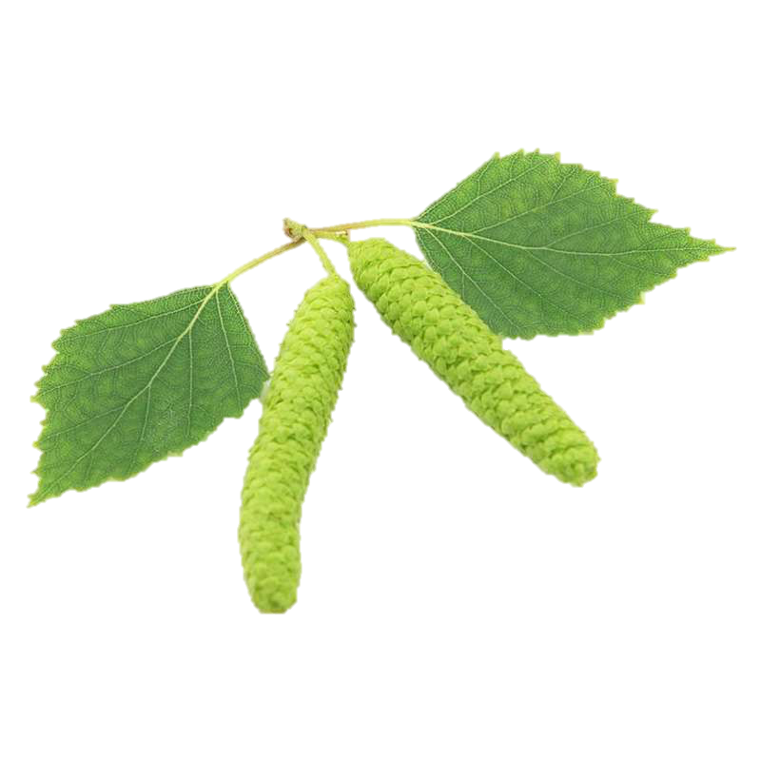
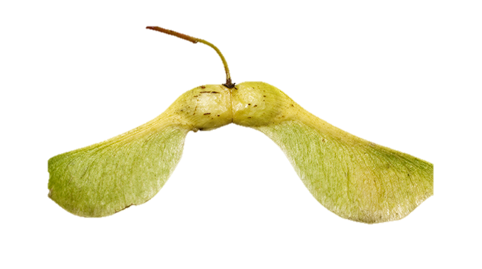
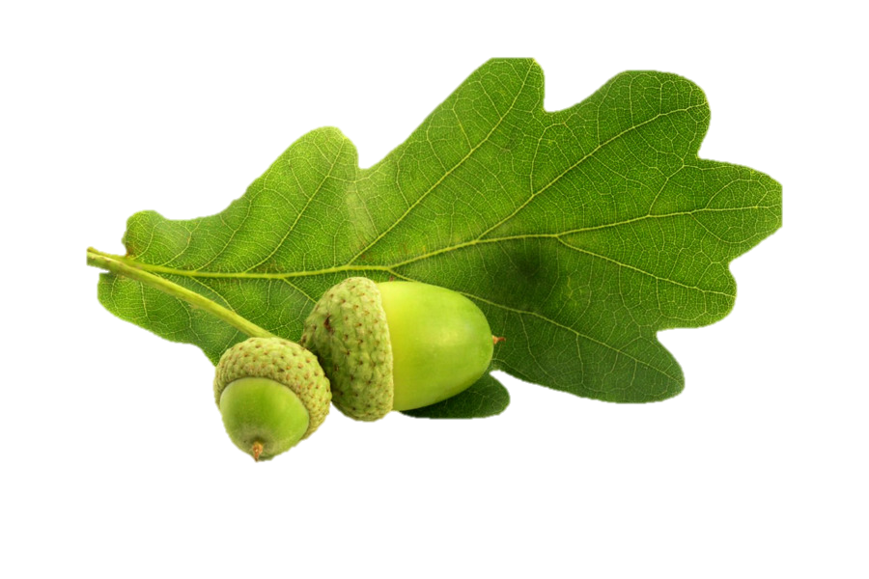

Slide 27
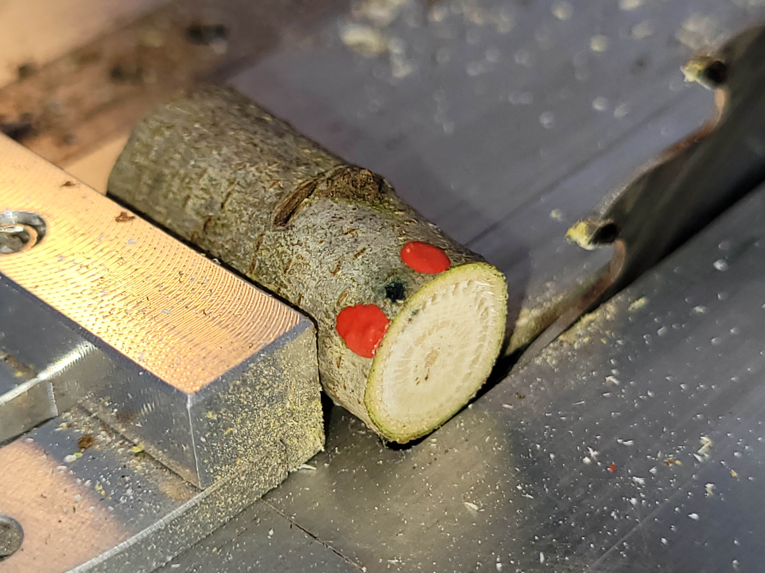
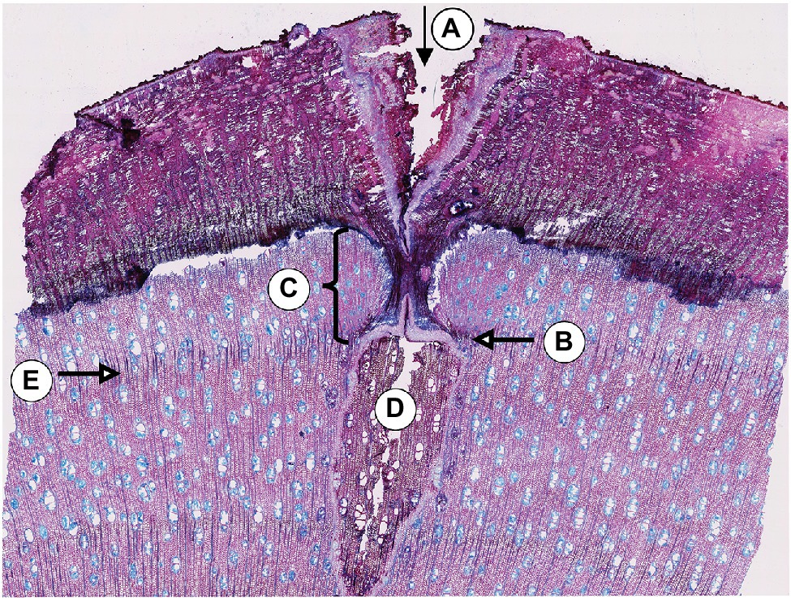
Next at WSL…
Gärtner & Farahat, 2021

Slide 28
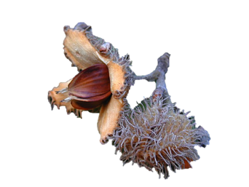
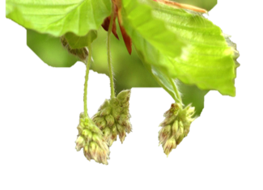
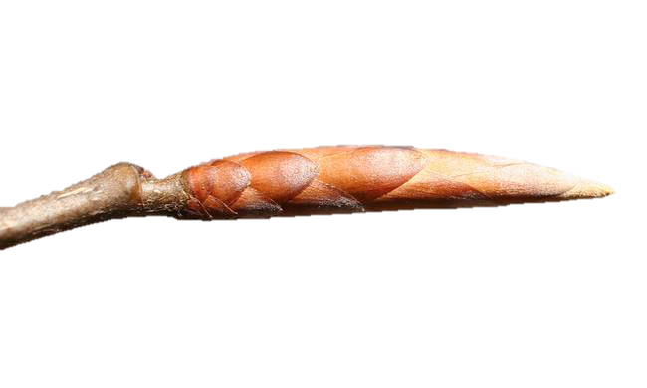

Phenological Cycle of Trees
time
Leaf senescence
Growing period
Bud set
Fruit ripening
Flowering
Leaf fall
Budburst
Wärme
Dormancy
leaf / reproductive phases
Tageslänge
bud phases
Kälte
modified from Delpierre et al. (2016)
Notes:
And to sense this crucial timepoint trees have only two indicators: Temperature and PP
But altough there are only these 2 main drivers it is rahter complex to understand and predict this phenological event.
After the growing seson a trees undergoes different stages
These three main drivers may interact also in time and surely across species
After release of Endodormancy, Photoperiod and Forcing temperature are the main drivers for leaf-out
Cold temperatures (Chilling)
Warm temperature (Forcing)

Slide 29
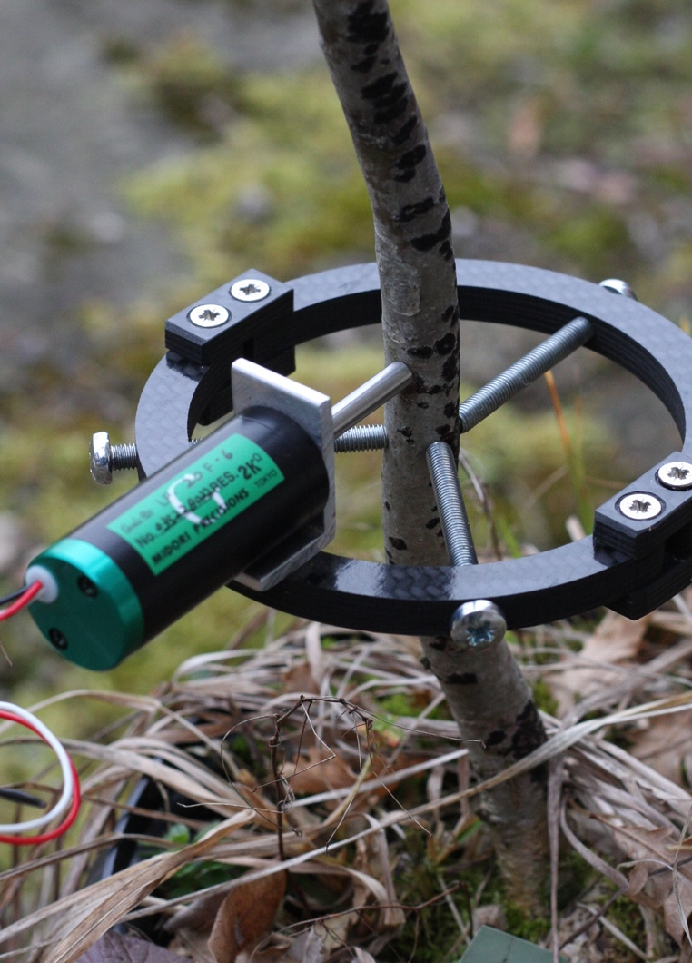
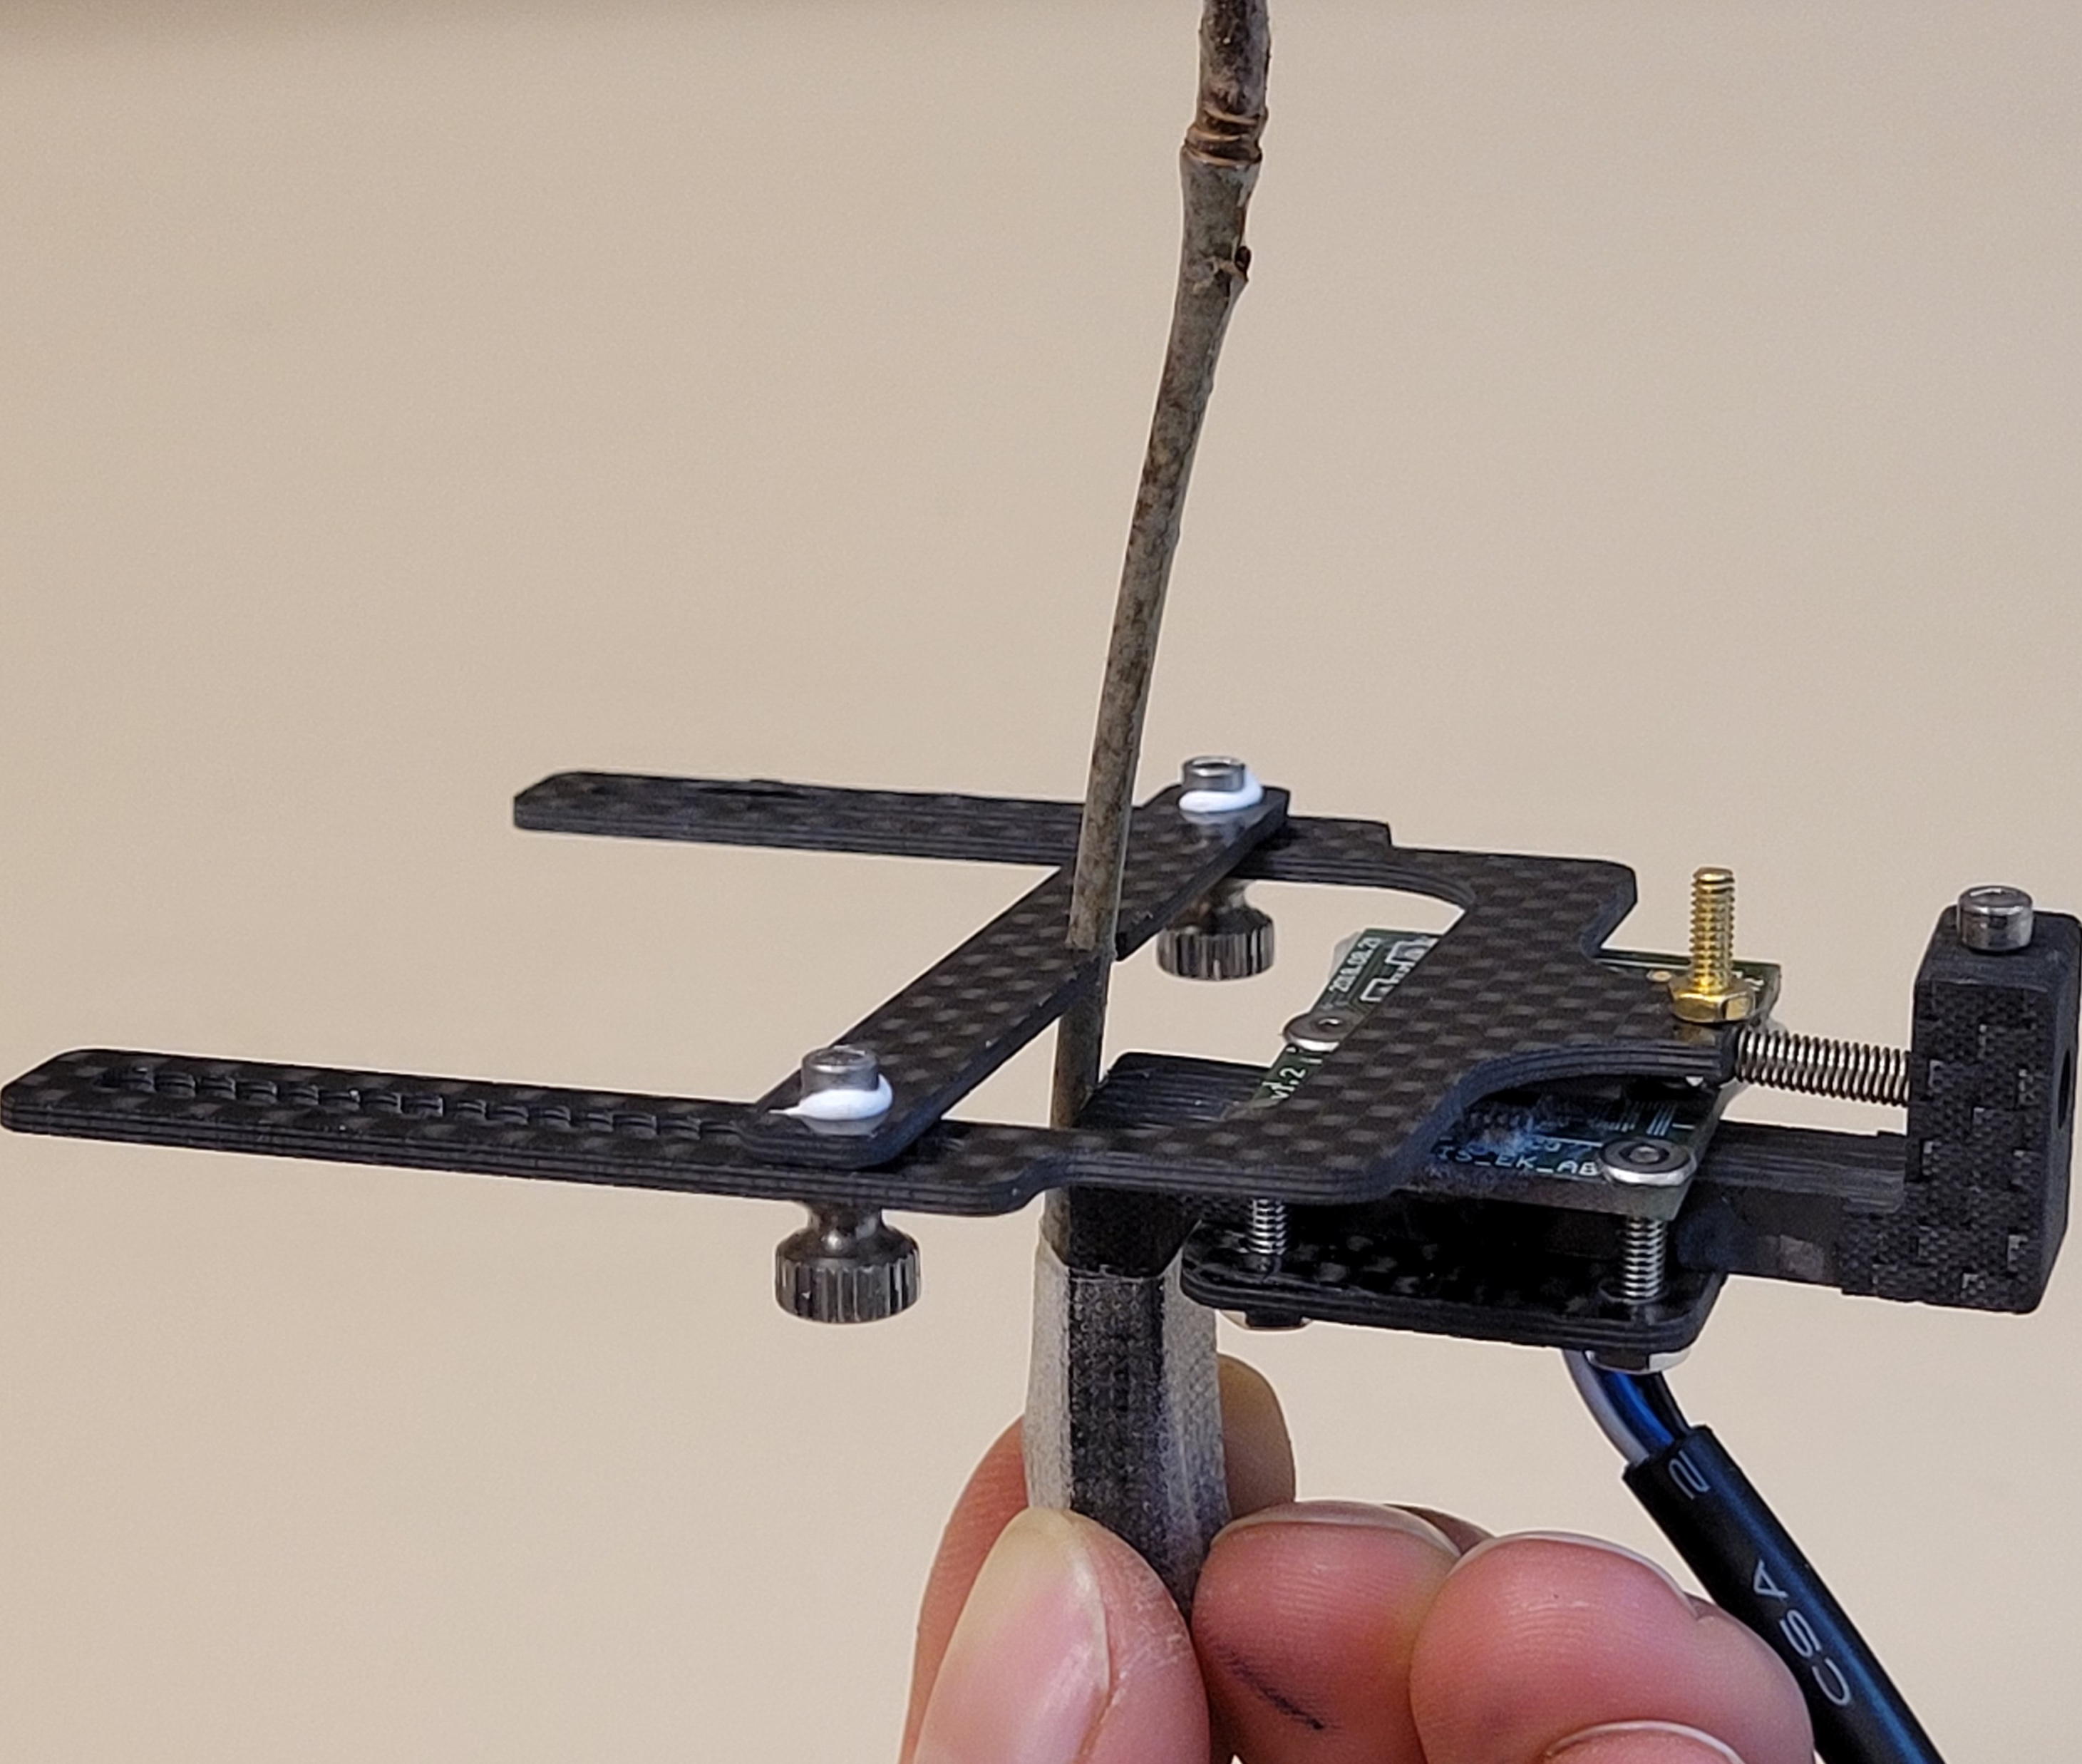
Sensors
Point dendrometer
Magnetic dendrometer
Notes:
And to sense this crucial timepoint trees have only two indicators: Temperature and PP
But altough there are only these 2 main drivers it is rahter complex to understand and predict this phenological event.
After the growing seson a trees undergoes different stages
These three main drivers may interact also in time and surely across species
After release of Endodormancy, Photoperiod and Forcing temperature are the main drivers for leaf-out
Cold temperatures (Chilling)
Warm temperature (Forcing)

